Slide 1

AIS Booking and JIRA Creation Slide Pack
Thanasekaran Varadharajan
Draft 0.1
30 July 2019

Slide 2
AIS Leads and Area
Design Area | Design Area 2 | Lead
DyNS SD WAN |  | Glew,R,Richard,TAQ2 R
DyNS - Edge/Virtualisation | DGS Transformation SD | Race,M,Mark,TAQ2 R
BT Connect |  | Scott,D,Dave,TAQ2 R
Contact, Voice & Collaboration |  | Brame,SM,Shaun,TAQ2 R
BT Connect |  | Scott,D,Dave,TAQ2 R
Contact, Voice & Collaboration |  | Brame,SM,Shaun,TAQ2 R
DGS Transformation SA |  | Varathappa Ganapathy,V,Vijay R
BT Connect |  | Scott,D,Dave,TAQ2 R
Security |  | Alexander,SJ,Stephanie,TAQ2 R

Slide 3
New Call Structure
Friday | 09:00 | 10:00 | DyNS SD WAN |  | Glew,R,Richard,TAQ2 R
Friday | 10:00 | 11:00 | DyNS - Edge/Virtualisation | DGS Transformation SD | Race,M,Mark,TAQ2 R
Thursday | 09:00 | 10:30 | BT Connect |  | Scott,D,Dave,TAQ2 R
Thursday | 11:30 | 12:30 | Contact, Voice & Collaboration |  | Brame,SM,Shaun,TAQ2 R
Wednesday | 09:00 | 10:30 | BT Connect |  | Scott,D,Dave,TAQ2 R
Wednesday | 11:00 | 12:00 | Contact, Voice & Collaboration |  | Brame,SM,Shaun,TAQ2 R
Tuesday | 07:30 | 08:30 | DGS Transformation SA |  | Varathappa Ganapathy,V,Vijay R | BT Connect -IPCG
Monday | 09.00 | 10:30 | BT Connect |  | Scott,D,Dave,TAQ2 R
Monday | 09:00 | 17:00 | Security |  | Alexander,SJ,Stephanie,TAQ2 R

Slide 4
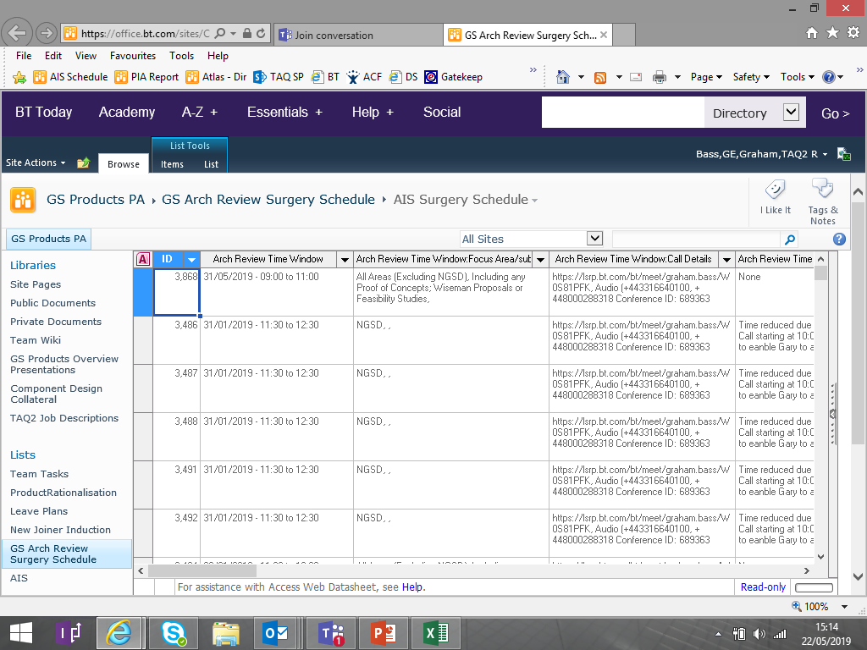
Booking AIS Slots
Use the below AIS link to book the slots:
https://office.bt.com/sites/CAO/DesignPoint/Gs%20designPoint/GSProductsPA/Lists/GS%20Arch%20Review%20Surgery%20Schedule/AIS%20Surgery%20Schedule.aspx
Below screen will be Populated :-

Slide 5
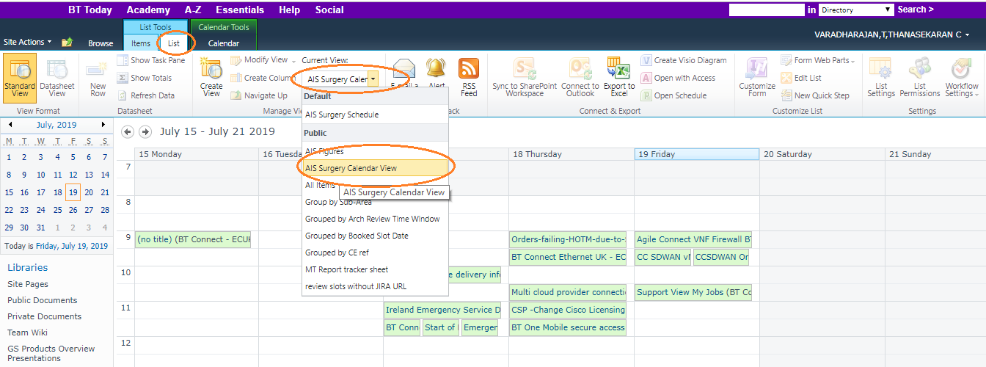
Booking AIS Slots - Find free Slots from Calendar View
Click on the “LIST”, then click on the “AIS Surgery Calendar View” LOV from create column in Menu.
Here, you could see the free slots available on the weekly basis and get an idea of list of free slots

Slide 6
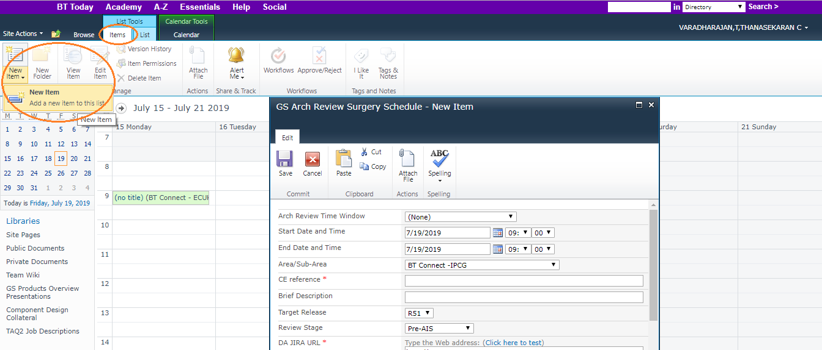
Booking AIS Slots – Create new slot
Once you find out the free slots, then Click on the “ITEMS”, then click on the “New Item” from Menu.
Here, you could see the POP up which should be filled

Slide 7
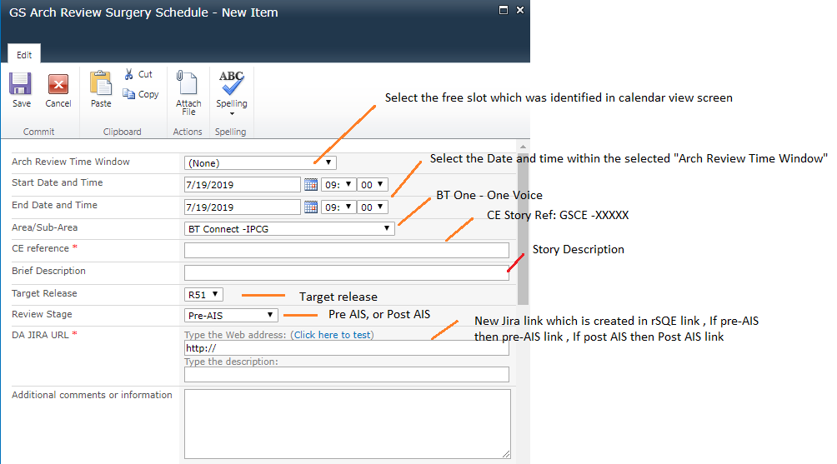
Booking AIS Slots – Enter the details
Enter the below details in New Item POP up

Slide 8
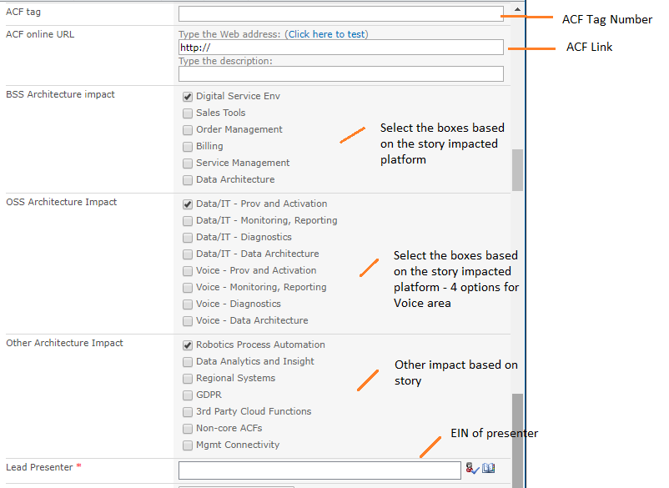
Booking AIS Slots – Enter the details
Enter the below details in New Item POP up and submit. Once Submit, then you could see your slot on the main page.

Slide 9
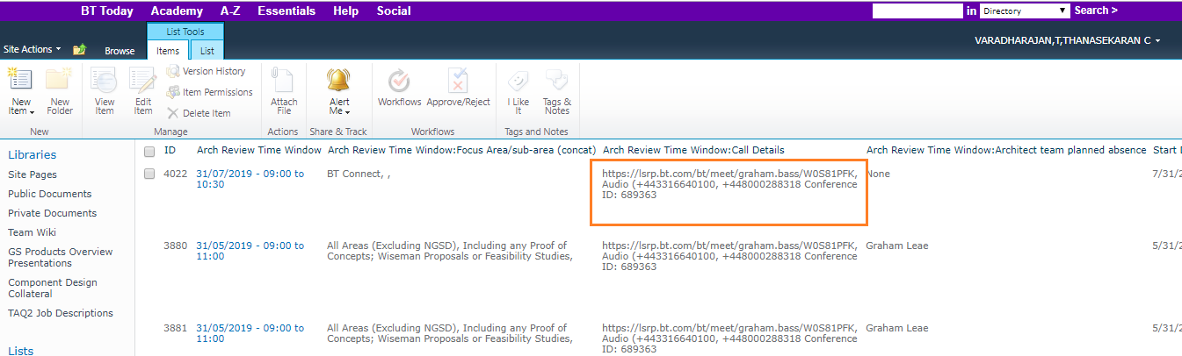
Booking AIS Slots
Please Note: Once you book the slot, you will NOT get any meeting invite from anyone. Hence you should either remember or book the meeting in your calendar for the same.
Please use the below link to join the call :
https://lsrp.bt.com/bt/meet/graham.bass/W0S81PFK, Audio (+443316640100, +448000288318 Conference ID: 689363

Slide 10
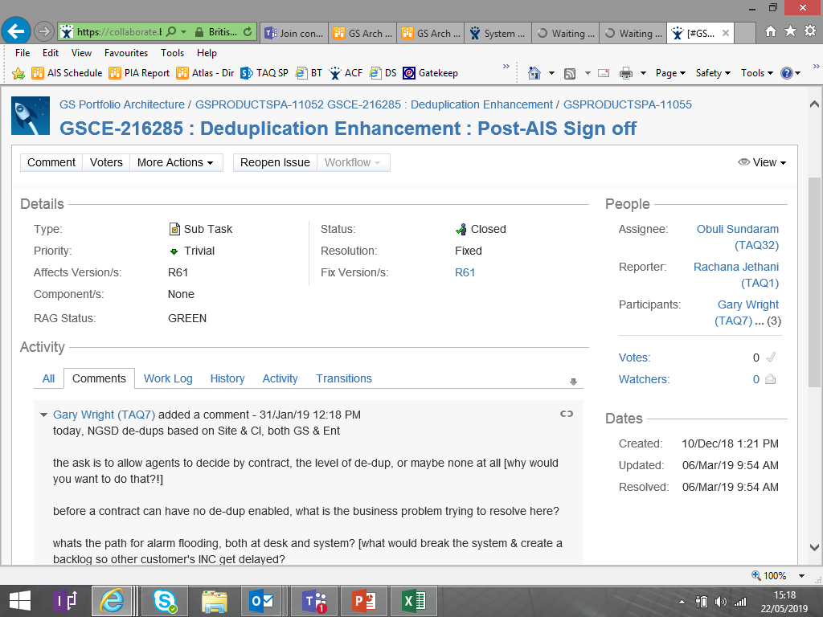
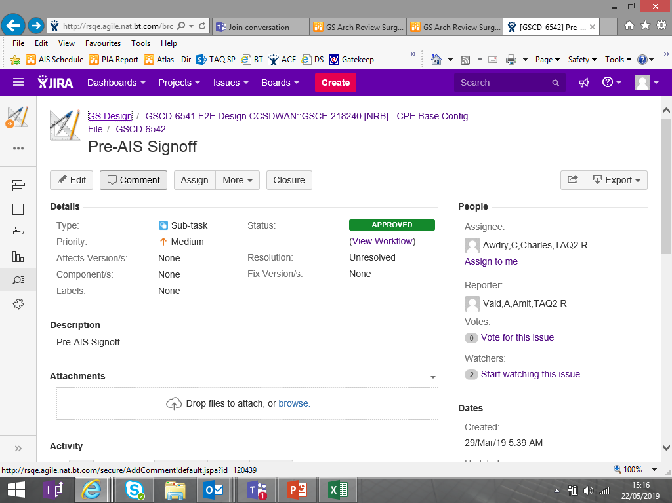
Moving to a new version of JIRA
BT is moved to New JIRA from the old one. Please use the new JIRA link for task creation
https://collaborate.bt.com/issues/secure/Dashboard.jspa
http://rsqe.agile.nat.bt.com/secure/Dashboard.jspa

Slide 11
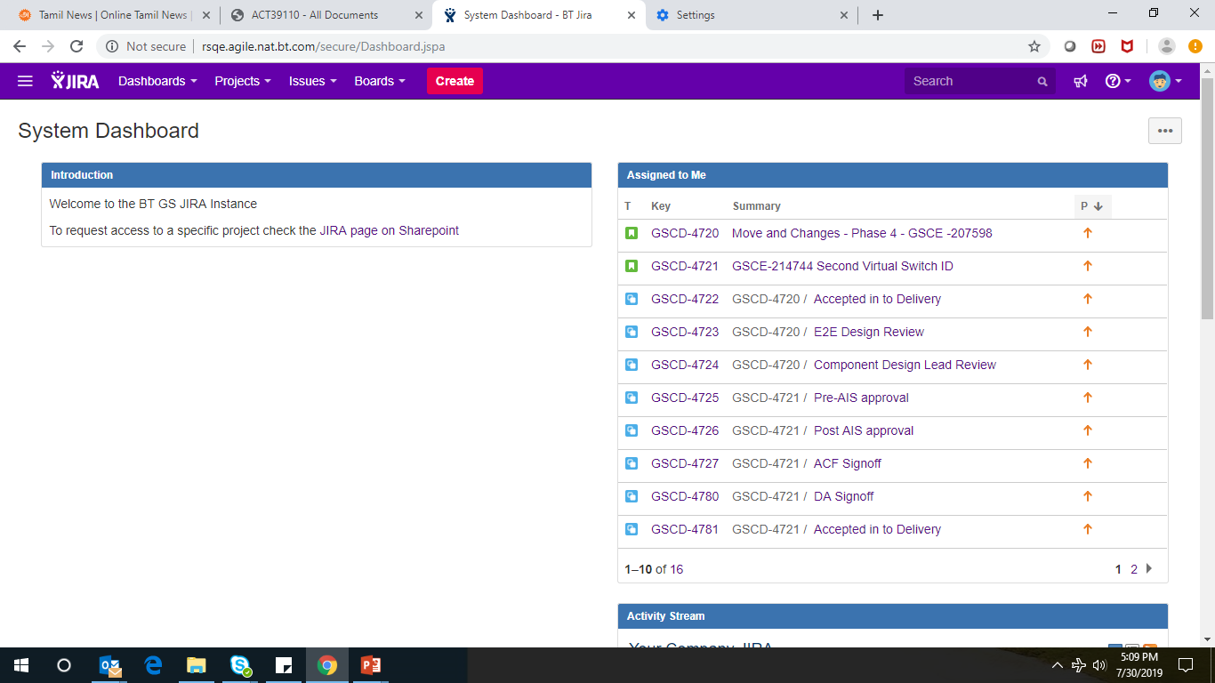
New JIRA Creation – Main Page
Use the below link to create the JIRA Issue for story:
http://rsqe.agile.nat.bt.com/projects/GSCD/
Below screen will be populated :-

Slide 12
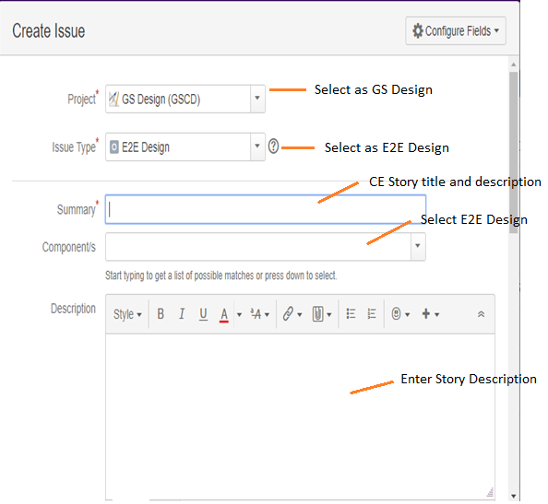
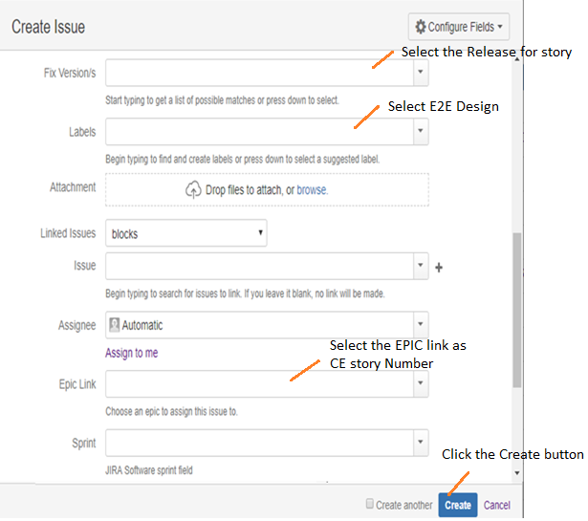
JIRA Creation – Enter Details
Click on the “Create” button then it would populate the below screens. Please fill the details accordingly.

Slide 13
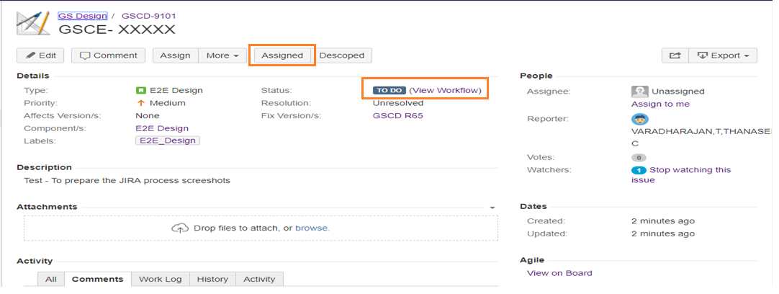
JIRA Creation - CA Phase
Once you complete the last slide and create the Issue, then you could see the below screen for your story.
Here, you could see the status is :TO DO, This is the status when design create the issue.
As soon as, the story is moved to CA phase, then we need to create the Pre-AIS task which is one of the QG for CA.
Click on the “Assigned” button to create the Pre-AIS task

Slide 14
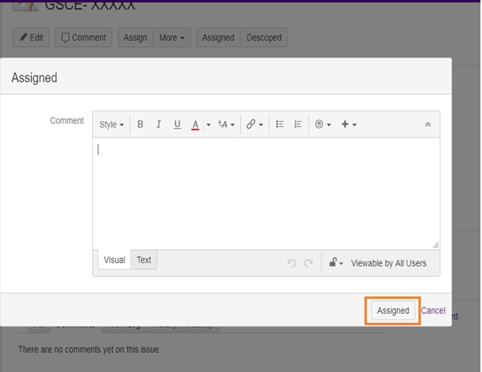
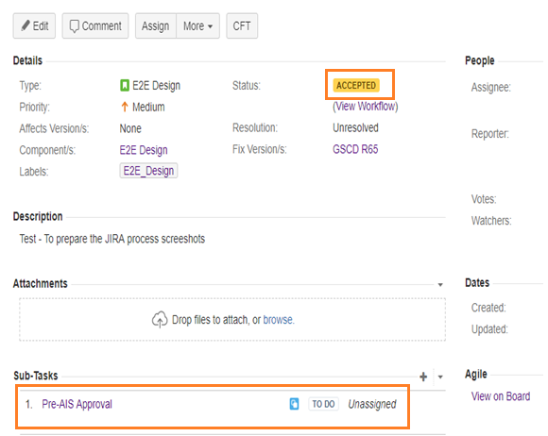
JIRA Creation – CA Phase
Once you click on the “Assigned” then you could see the below POP up, click assigned again.
Your Story status changed from “TO DO” to “ Accepted” and “Pre-AIS Approval” task is generated automatically.
Here, Pre-AIS Approval task is not assigned to any architect, hence we should assign the task against architect by click on the task.

Slide 15
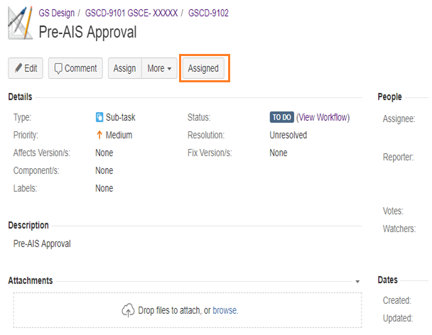
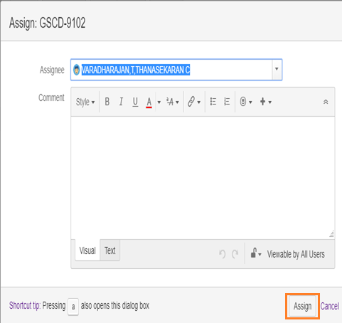
JIRA Creation – CA Phase
Once you click on the “Pre-AIS Approval” task, then you could see the below screen.
Please click on the “Assigned” button, the new below POP up would be populated.
Here select the Architect name and click on the assign button. It would be assigned to the selected architect automatically (Please use this link while booking the Pre-AIS slot)

Slide 16
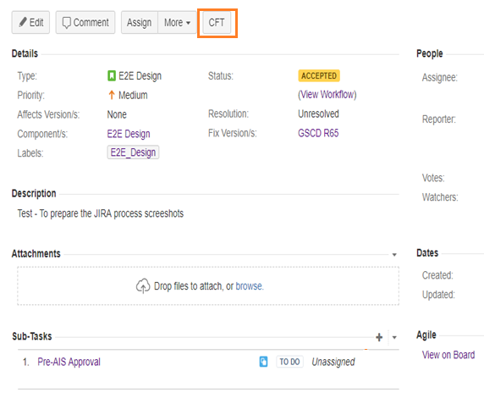
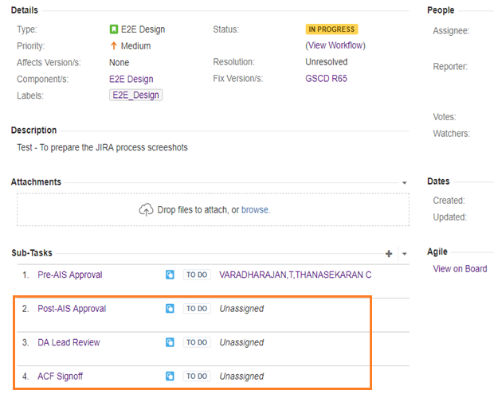
JIRA Creation – CFT Phase
Once the CA QG are completed and story moved to CFT then, Click on the “CFT” button, new POP up would be generated, By clicking on the CFT button , 3 (Post AIS, DA Review, ACF Signoff) task would be generated automatically.
Here, you could see the story status moved to “IN progress” from “Accepted”

Slide 17
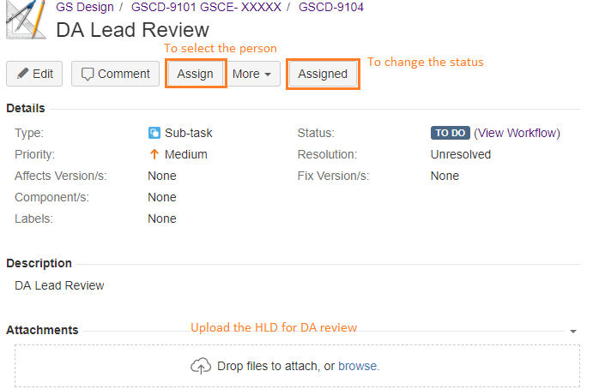
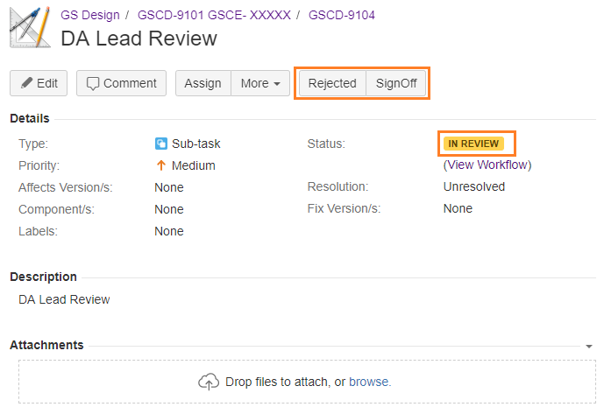
JIRA Creation – CFT Phase
Click on the CFT, We could see 3 task. Now we should assign the task to respective person.
E.g. For DA Lead Review, Click on “Assign”, then you can select the DA lead name and submit. Once you assign, Click on the “Assigned” button and submit.
Now you could see story status moved to “In Review” and 2 buttons enabled for signoff/Reject.

Slide 18
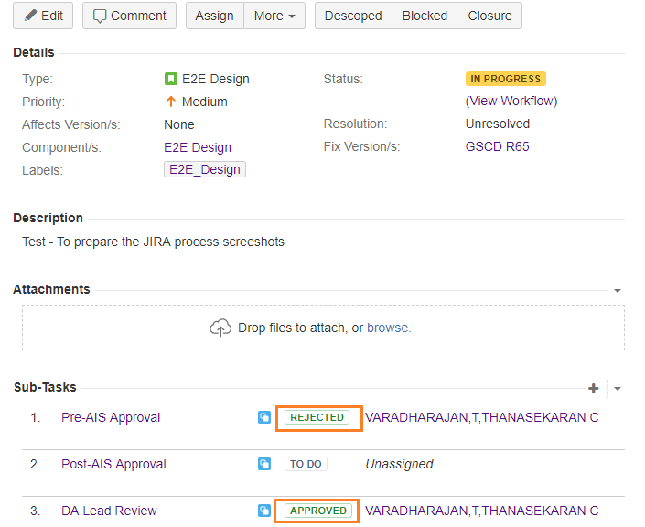
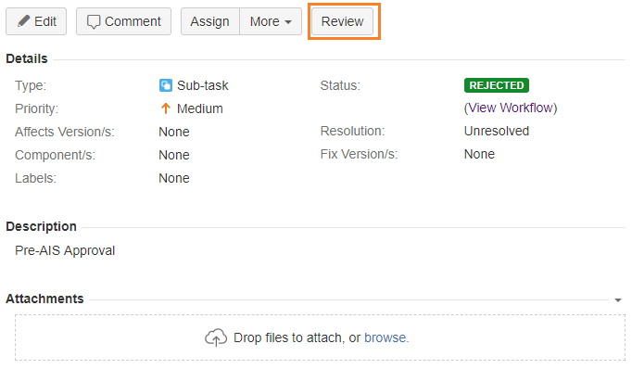
JIRA Creation – CFT Phase
If Architect/DA approve the Pre-AIS / DA lead Review then the task would be closed automatically.
If Architect/DA reject the Pre-AIS / DA lead Review then designer should Review the task again by clicking the “Review” button. So that your task moved to “Review” again from “Rejected” and you could see the Signoff/Reject button

Slide 19
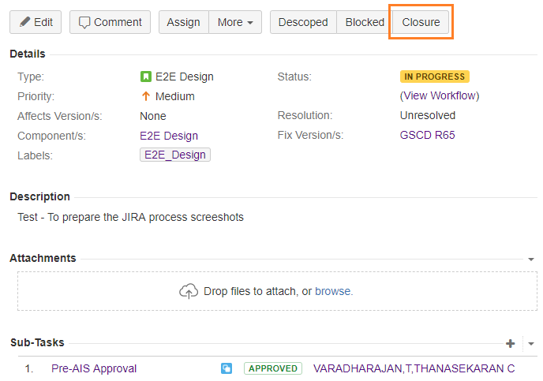
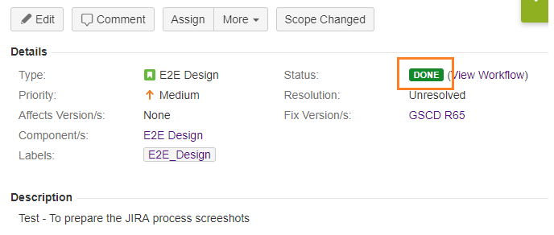
JIRA Creation – Story Closure
Once all the sub tasks are closed/approved then you can close the story by clicking the “Closure” button.
Once closure the story, you could see the status of the story as “DONE”

Slide 20
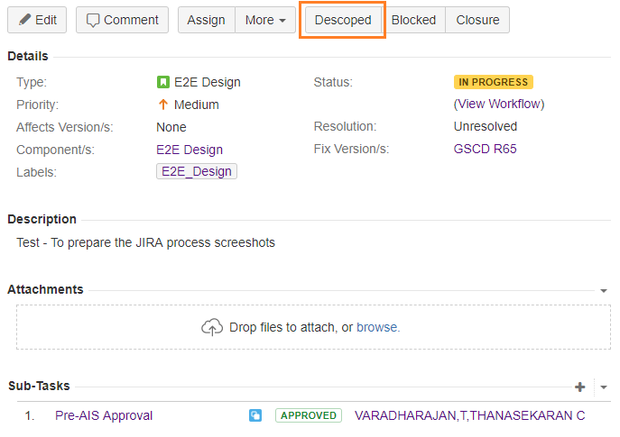
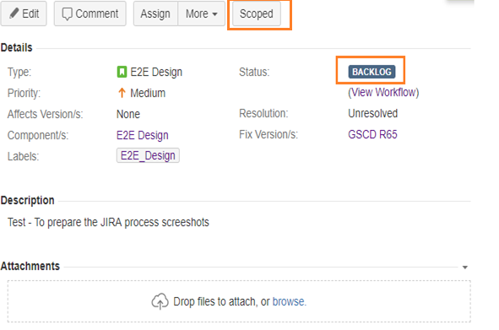
JIRA Creation – Backlog
In case the story is de-scoped then, click on the “Descoped” button and submit. Once you submit the story, you could see the status of the story as “BACKLOG”.
In case if you would like to scope again, then it can be enabled by clicking on the “Scoped” button

Slide 21
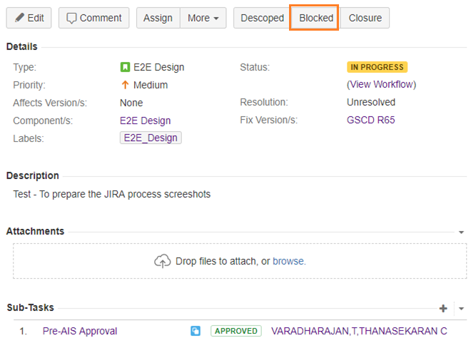
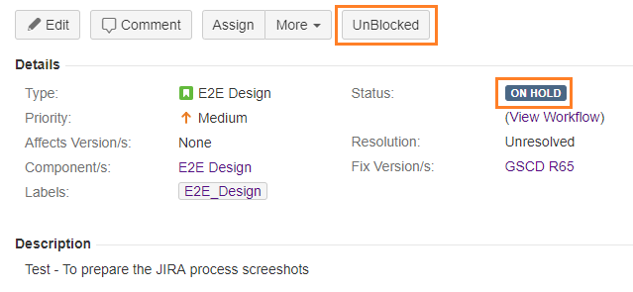
JIRA Creation – On Hold
In case the story is “ON Hold” then, click on the “Blocked” button and submit. Once you submit the story, you could see the status of the story as “ON HOLD”.
In case if you would like to progress again, then it can be enabled by clicking on the “Unblocked” button

Slide 22
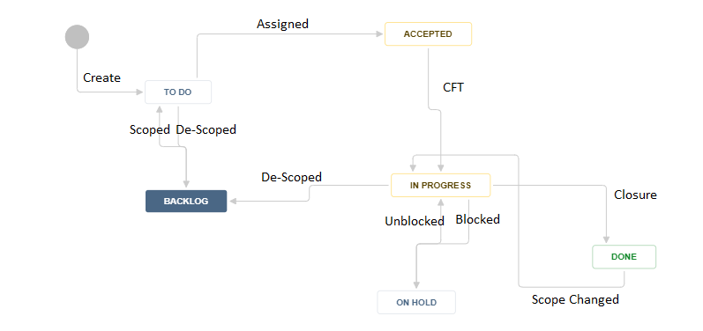
JIRA Creation – E2E Flow
E2E flow diagram for JIRA Creation :-

Slide 23
Useful Links
JIRA
http://rsqe.agile.nat.bt.com/projects/GSCD/
AIS Booking Schedule
https://office.bt.com/sites/CAO/DesignPoint/Gs%20designPoint/GSProductsPA/Lists/GS%20Arch%20Review%20Surgery%20Schedule/AIS%20Surgery%20Schedule.aspx
AIS SharePoint Site
https://office2.bt.com/sites/BTGS-C2M-SolutionDesign/SitePages/AIS.aspx

Slide 24
JIRA Access
Request Access:
Place an order in Order Gateway for System Access -> IUSER Domain (Group Connection)
Fill in “jira-software-project-gs-component-design” in the group required.
Submit

